Slide 1


Share Me
Submitted By:
Anuj Garg(1900970100024)
Anurag Chauhan(1900970100025)
Submitted To:
Dr. Inderpreet Kaur
Ms. Renu Mishra

Slide 2
Introduction
Share Me is a file sharing application basically based on managing files and sharing them over a hotspot.
If two or more than 2 system are connected then we can send file(s) to any number of users as desired.
Users can send a text file(.txt),picture file(.png/jpeg),videos file(.mp4) and etc.
It is made of two application : one Server side and the other the Client. To start sending files any one of them have to set IP address of the other.

Slide 3
Working
The application used HyperText Transfer Protocol(HTTP) to send the files.
HTTP was invented by Tim Berner Lee with W3C ,IETF,RFC and ISO organization.
It is a protocol for transfer of various data format between server and client.
HTTP is a Application layer protocol i.e it do useful work like sending and receiving message or transfer files

Slide 4
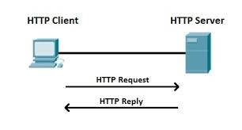
Flow Of Data
An HTTP client send a request message to an HTTP server.
Server return a respond message

Slide 5
Working(Cont..)
When this request message reaches the server, the server can take either one of these
actions:
The server interpret the request received,maps the request into a file under the servers document directory,and return the file requested to the client.
The server interprets the request received,maps the request into a program kept in the server,executes the program,and return the output of the program to the client.
The request cannot be satisfied,the server returns an error message.

Slide 6
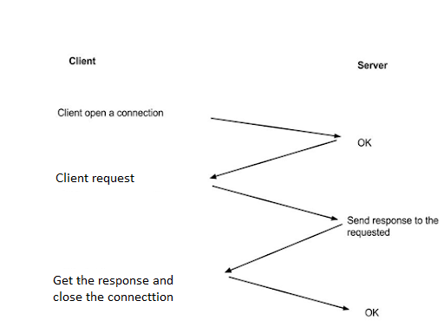
An HTTP Conversation

Slide 7
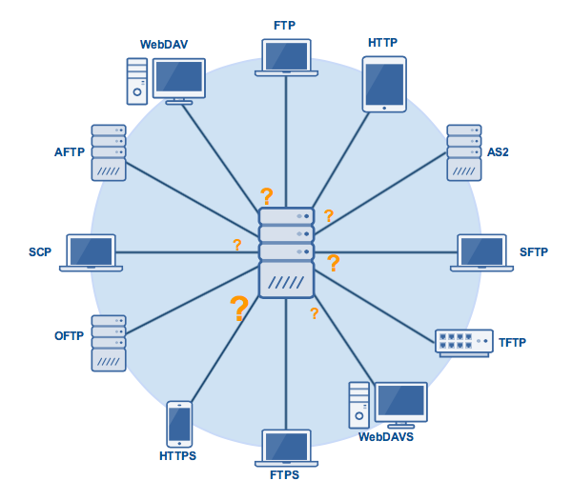
Other Protocols

Slide 8
Software Requirements
Operating System : Windows (7 or above)
Drivers : Java Runtime Environment
Eclipse 4.12 IDE
Spring Boot 2.2.1
JavaFx 11
Spring Builder 2.3.0

Slide 9
Hardware Requirements
i3 Processor
5MB of hard drive space
500MB of RAM

Slide 10
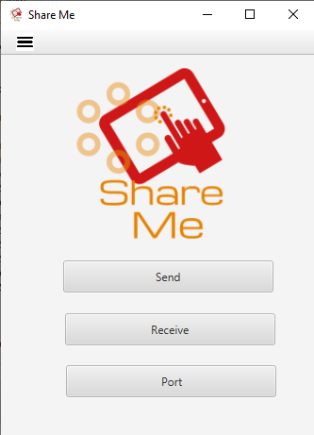
Result
Home screen of the application

Slide 11
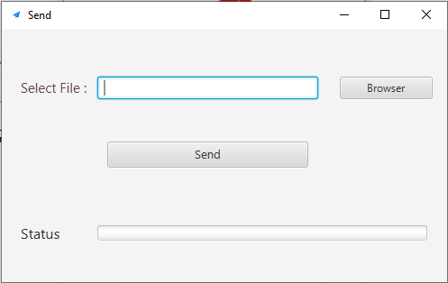
Result
Send view

Slide 12
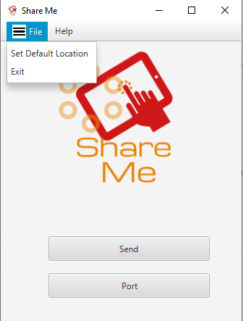
Result
Main View

Slide 13
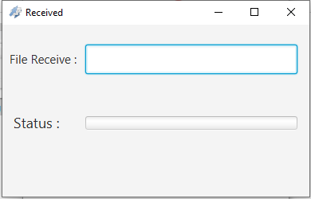
Result
Received view

Slide 14
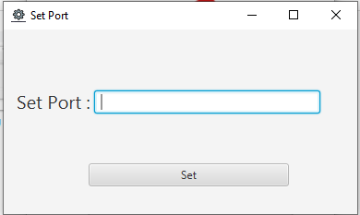
Result
Set IP address view

Slide 15
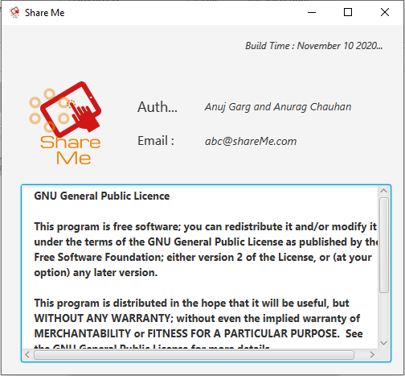
Result
About view

Slide 16
Conclusion
Allowing users to send and received all type of files.
It allow the users to set default storage location: This is achieved using the “Set default location menu” in the menubar.
Users will see a success message after receiving the files.

Slide 17
Future Scope
Files can be send to a group of peoples.
Application will be more user friendly.
More features will be added like: users can chat to each other, users can also share their screen and many more.
Users will not have to put IP address manually.

Slide 18
References
www.wikipedia.com
www.googleimage.com
www.javatoint.com

Slide 19



Thank You..

